Slide 1




SONG ANALYSIS
USING POWER BI |
Presented By-
Suprakrit Debnath
Batch:DA-10

Slide 2

Overview
This project analyzes YouTube song data using Power BI to uncover insights into performance, engagement, and trends. By examining key metrics such as views, likes, and comments, the analysis provides actionable recommendations for content optimization. The goal is to help content creators and stakeholders understand audience preferences, improve video performance, and enhance engagement and visibility on the platform.

Slide 3


Process Overview
02
Dashboard
03
Recommendation
01
Data Cleaning
Prepare and preprocess the dataset
Creation
Load data into Power BI and build Dashboards
s
Analyze visualizations and provide actionable advice

Slide 4

Dataset Description
★ video_id: Unique identiﬁer for each YouTube video.
★ channelTitle: Title of the YouTube channel publishing the song.
★ title: Title of the YouTube song video.
★ description: Description provided for the YouTube song video.
★ tags: Tags associated with the YouTube song video.
★ publishedAt: Date and time when the YouTube song video was published.
★ viewCount: Number of views received by the YouTube song video.
★ likeCount: Number of likes received by the YouTube song video.
★ favoriteCount: Number of times the YouTube song video has been marked as a favorite.
★ commentCount: Number of comments posted on the YouTube song video.
★ duration: Duration of the YouTube song video.
★ deﬁnition: Video deﬁnition or quality (e.g., HD, SD).
★ caption: Availability of captions for the YouTube song video.

Slide 5


Data Cleaning
Prepare and Preprocess the dataset
01

Slide 6
❏ Handle Missing Values: Identify and address missing or incomplete data entries.
❏ Date Formatting: Convert and standardize date and time formats for consistency.
❏ Feature Extraction: Extract and create relevant features for analysis (e.g., extracting the month from the publish date).
❏ Data Transformation: Normalize and transform data ﬁelds as needed for accurate analysis.
❏ Data Validation: Ensure data accuracy and consistency throughout the dataset.

Slide 7



Dashboard Creation
02
Load data into Power BI and build Dashboards

Slide 8

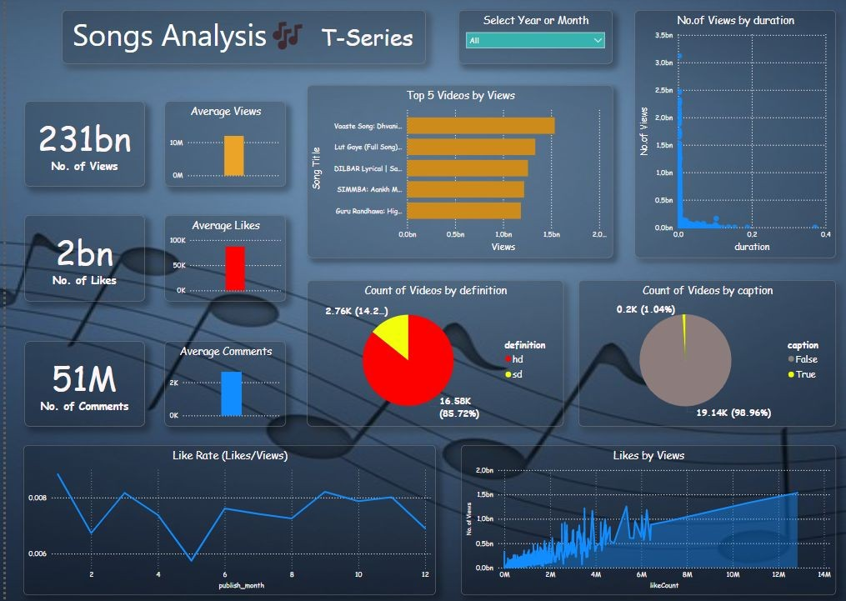
Dashboard Design

Slide 9
Dashboard Visuals
★ Total Views: Displaying a total of 231 billion views.
★ Total Likes: Displaying a total of 2 billion likes.
★ Total Comments: Displaying a total of 51 million comments.
★ Average Views, Likes, and Comments: Highlighting average metrics per video.
★ Top 5 Videos by Views: A bar chart showing the top 5 videos with the highest views.
★ Views by Duration: A scatter plot showing the number of views in relation to video duration.
★ Videos by Deﬁnition: A pie chart displaying the count of videos in HD and SD quality.
★ Videos with Captions: A pie chart showing the count of videos with and without captions.
★ Like Rate: A line chart showing the Like Rate (Likes/Views) over different publish months.
★ Likes by Views: A line area chart depicting the relationship between likes and views.

Slide 10

Recommendations
Analyze visualizations and provide actionable advice
03

Slide 11
❏ Leverage popular songs: Create more content around songs similar to the top 5 videos by views.
❏ Optimize video length: Keep videos concise for higher view counts.
❏ Improve video quality: Upload videos in HD for better engagement.
❏ Add captions: Increase accessibility with captions.
❏ Boost like rate: Use call-to-action prompts to encourage likes.
❏ Post at optimal times: Identify best times to post using publish_month data.
❏ Engage with audience: Encourage comments to boost interaction.

Slide 12
Conclusion
Analyzing YouTube song data provides valuable insights for optimizing content strategies. By leveraging key metrics and trends, content creators can enhance video performance, engage with audiences more effectively, and ultimately achieve greater success on the platform.

Slide 13

THANK YOU

